Slide 1

Manual B2B
Add Member or Administrator

Slide 2
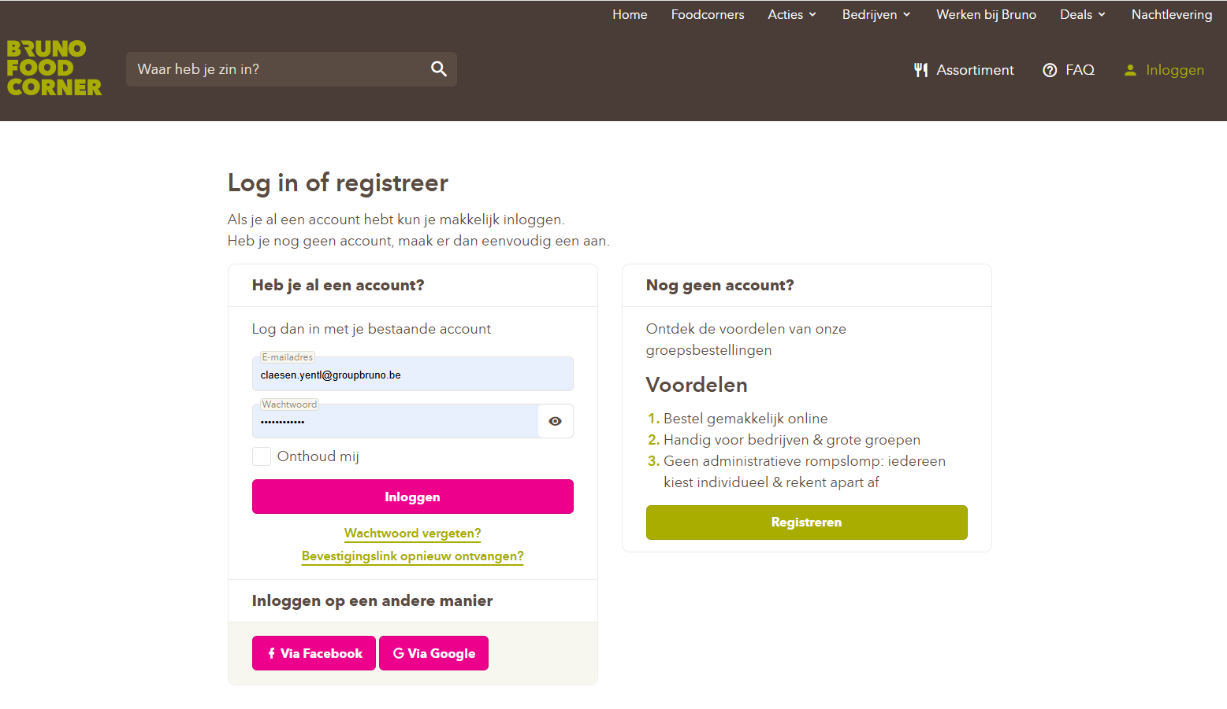

Step 1: Go to https://www.brunofoodcorner.be/nl and log in with your email address and password.

Slide 3
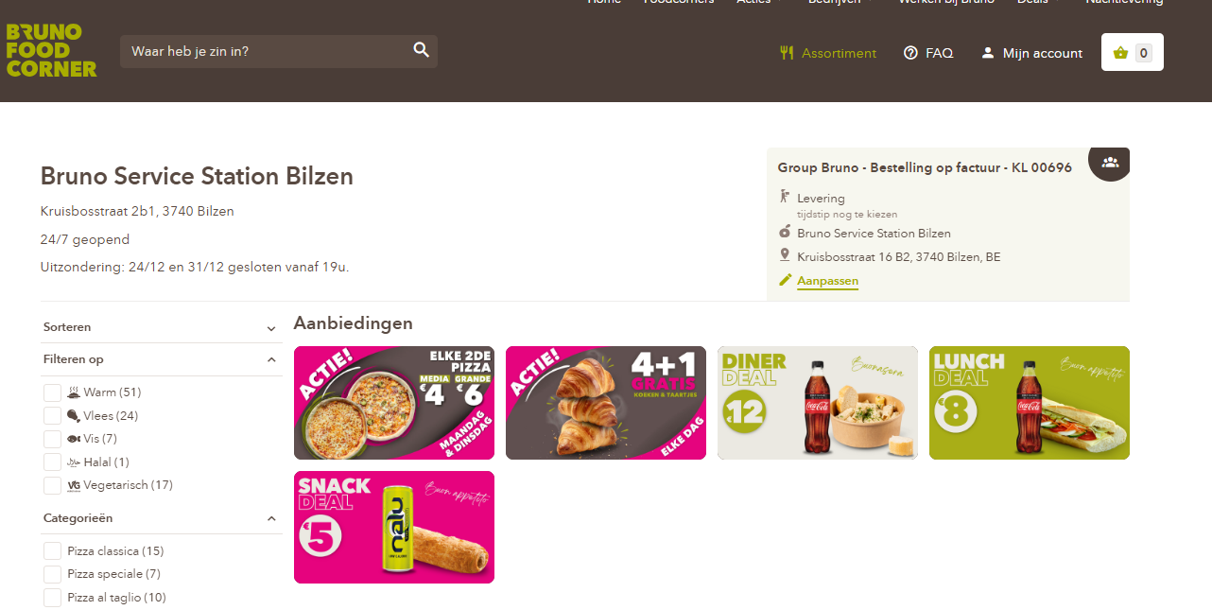
Step 2: Go to (Mijn account).

Slide 4
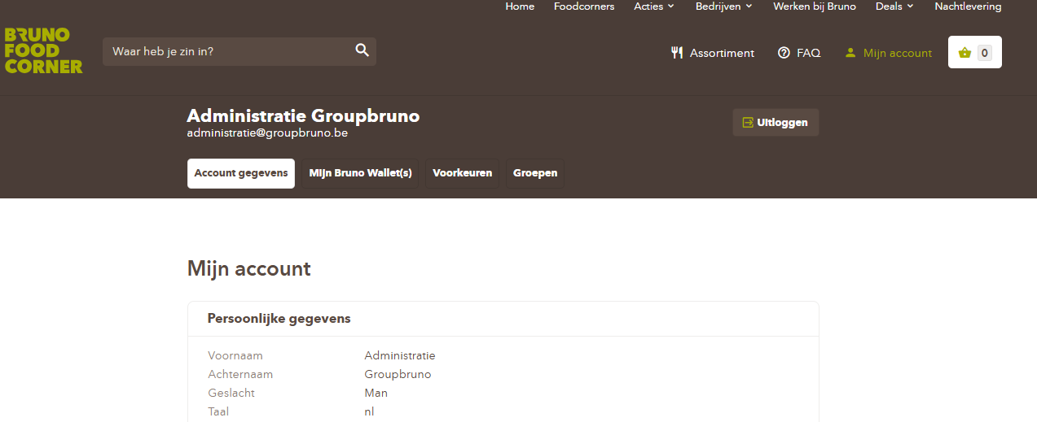
Step 3: Click on the tab (Groepen).

Slide 5
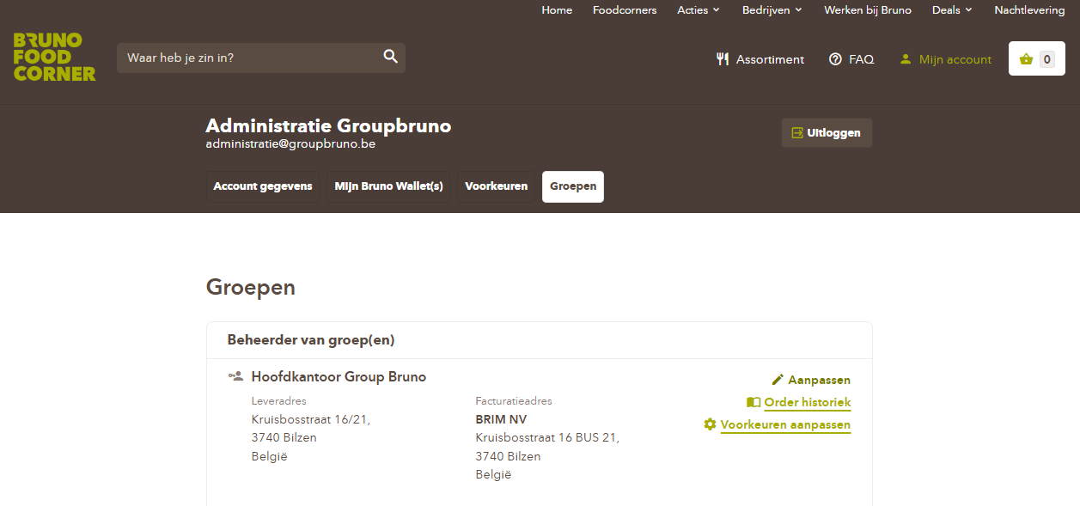
Step 4: Select the group you want and click on the pencil icon with (Aanpassen).

Slide 6

Step 6: Enter the email address you want to add and click on (Uitnodigen).
PLEASE NOTE: The email address you are inviting must already have an account before it can be invited. If this is not yet the case, you will first need to create an account and then you can invite them.

Slide 7
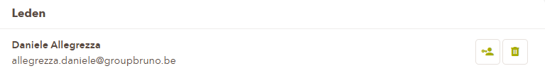
Make person administrator: If you want to make someone an administrator of the group, simply click on the plus sign with the little man next to it.

