Slide 1

Manual for B2B group orders
How to order as a member

Slide 2
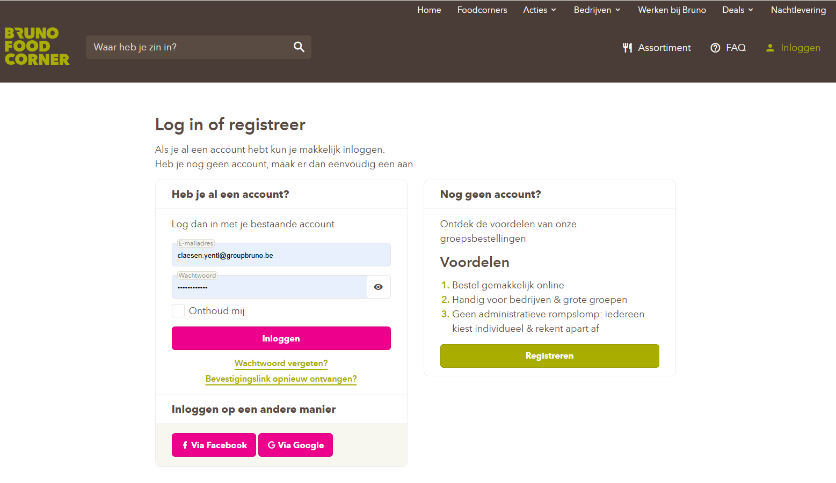

Step 1: Go to https://www.brunofoodcorner.be/nl and log in with your email address and password.

Slide 3
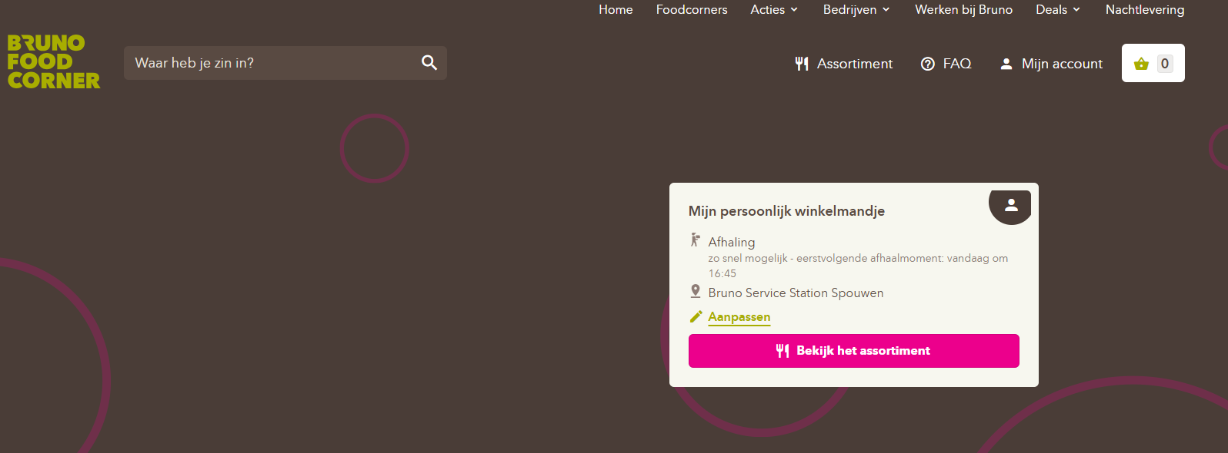
Step 2: Click on the pencil icon labeled (Aanpassen)

Slide 4
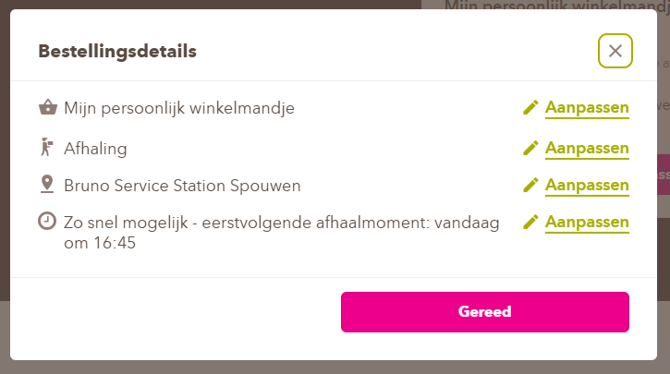
Step 3: Click again on the pencil icon (Aanpassen) next to ‘Mijn persoonlijk winkelmandje’ to edit it.
(Please note that if you want to place a personal order, you will need to adjust this setting.)

Slide 5
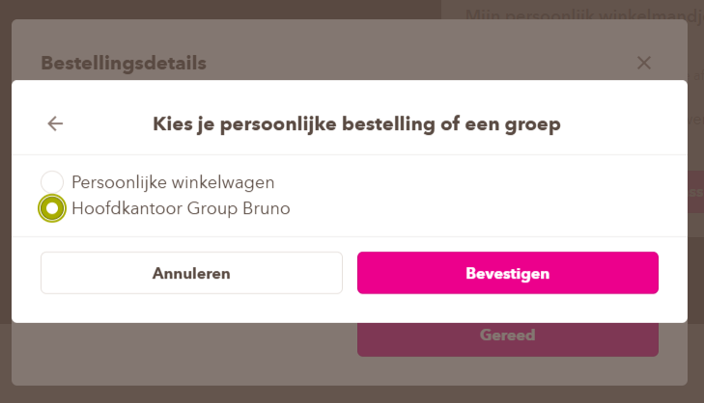
Step 4: Indicate on the basis of the (Dot) your group and then click on (Bevestigen)

Slide 6
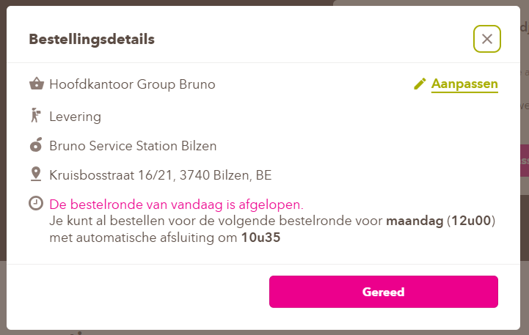
Your details have now been automatically adjusted to the group you have selected
If your details are correct, click on (Gereed)

Slide 7
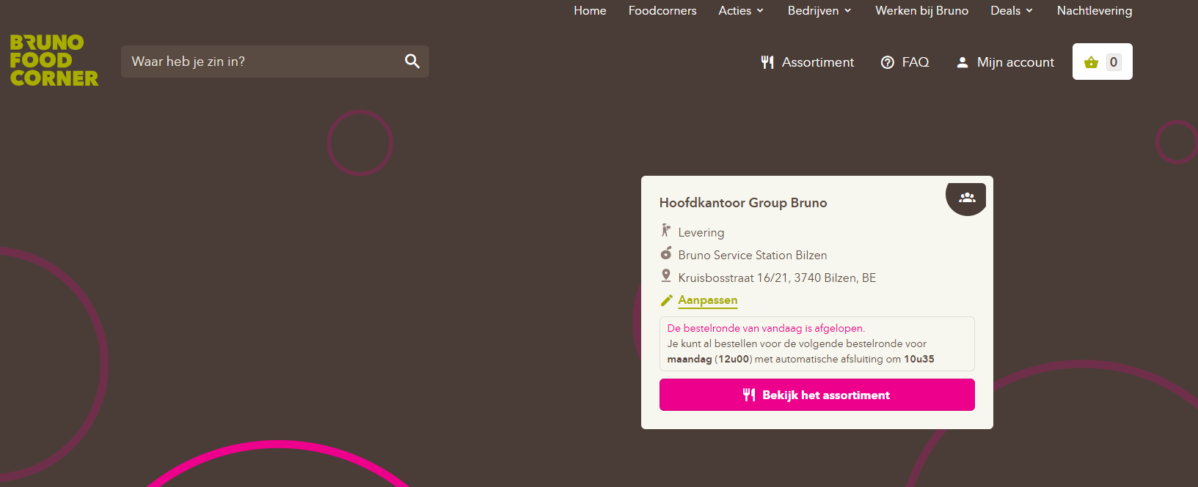
Step 5: Click on (Assortiment) and start choosing your delicious meal

Slide 8
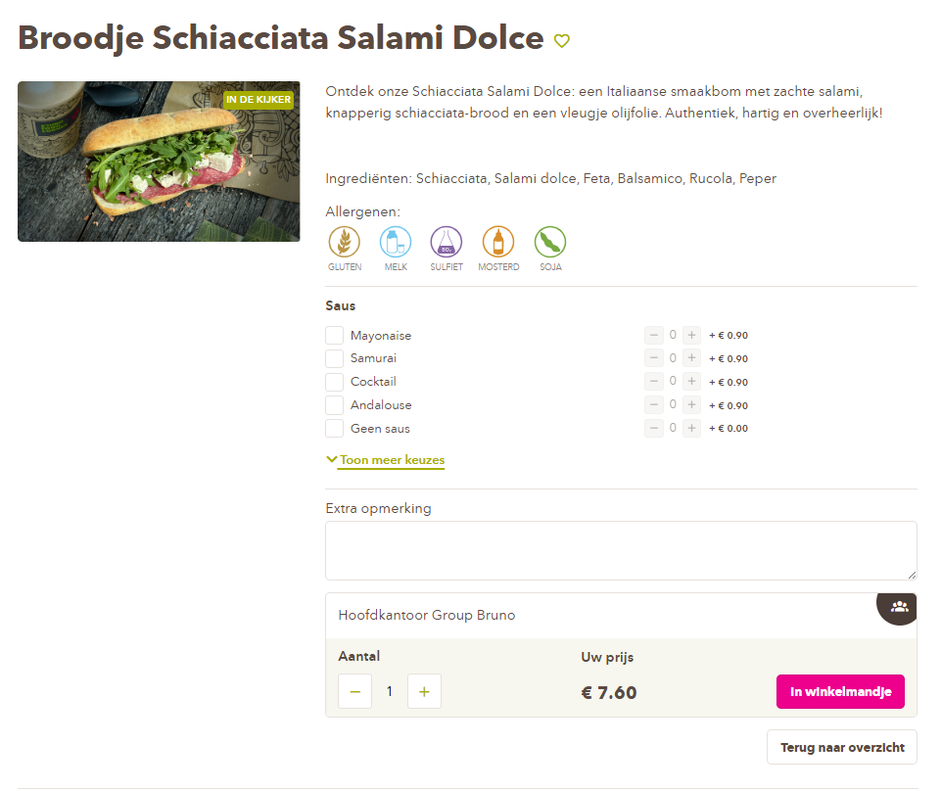
Stap 6: Select your preferences and then add to your shopping cart at the bottom of the page
Double-check here to see if your group name is still listed

Slide 9
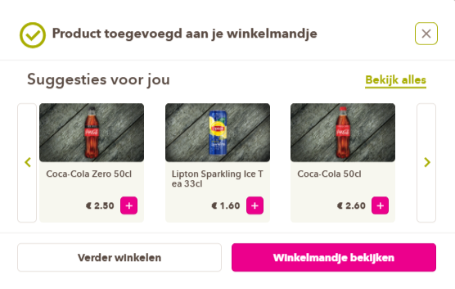
Step 7: Click on (Winkelmandje bekijken)
If you want to add additional products, click on (Verder winkelen) and repeat step 6

Slide 10
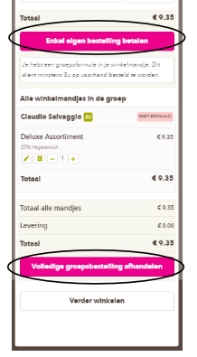
Step 8: Check your details and your order again and click on (Enkel eigen bestelling betalen)
If the company wants to provide a treat for its employees, this is possible. All members of the group must place their orders in the shopping cart and not pay for them. The group administrator can then pay for the entire shopping cart by clicking on (Volledige groepsbestelling afhandelen)

Slide 11
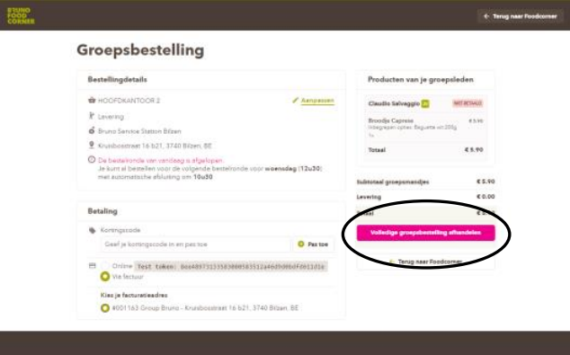
Step 9: A group administrator can choose whether to pay online or by invoice.
Select the desired payment option and then click:
If you clicked on (Enkel eigen bestelling betalen)
➔ Pay for your own order
Only to pay for your private order
Once you have clicked on (Volledige groepsbestelling afhandelen)
➔ Pay for entire group order
To pay for the entire group basket

Slide 12
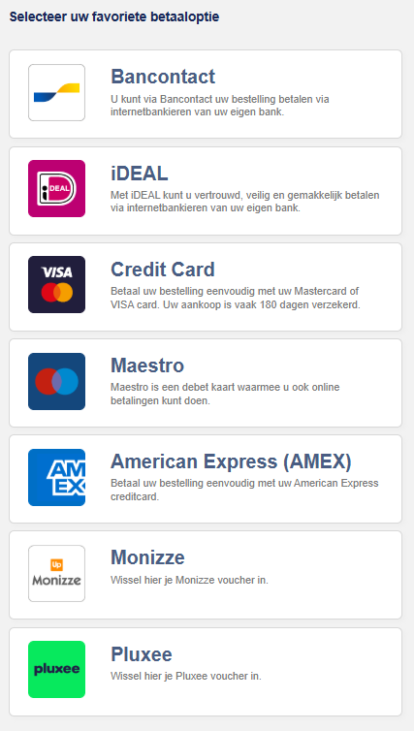
Step 10: Pay using your preferred payment method

Slide 13
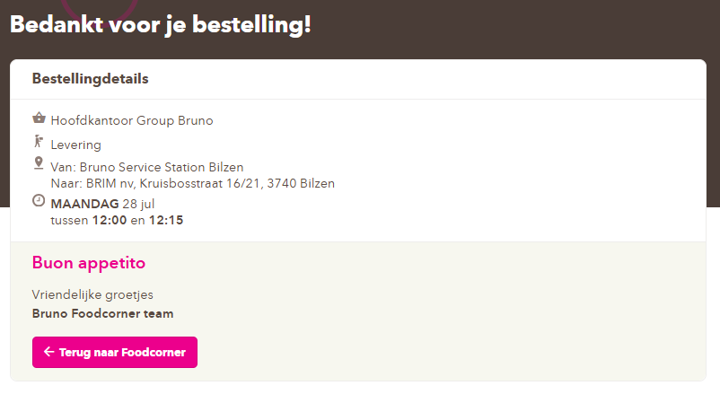
Once your payment has been successful, you will receive a confirmation and a confirmation email within a few minutes.

Slide 14
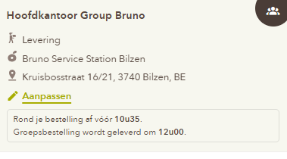
Extra info: You must place your order before a certain time to receive your products on the same day
You can find this information when you edit your shopping cart
Please note: If you order after this time, your order will not be delivered until the next day.

Slide 15
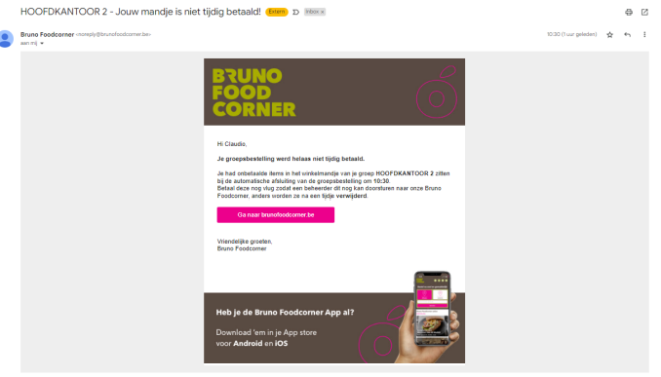
Extra info: If a member adds something to their shopping cart before the delivery time and after closing time
the administrator will receive a notification via email

