Slide 1

Handbook for B2B group orders
How to order as a Member?

Slide 2
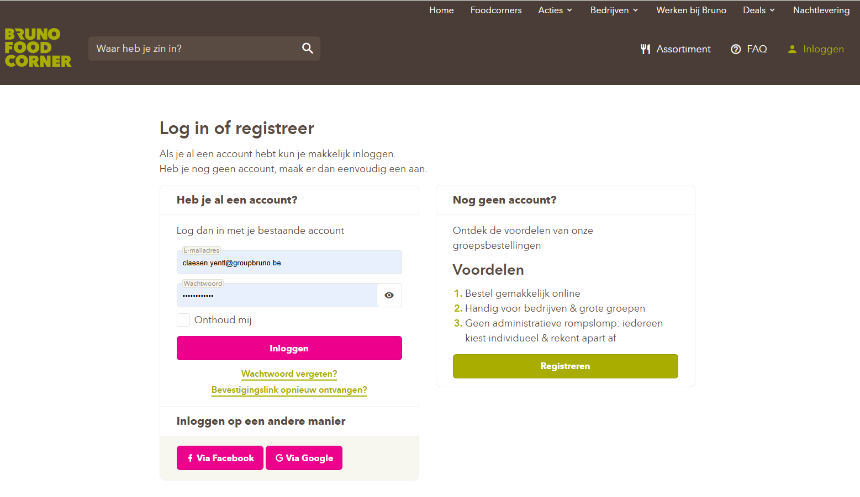

Step 1: Go to https://www.brunofoodcorner.be/nl and log in with your email address and password.

Slide 3
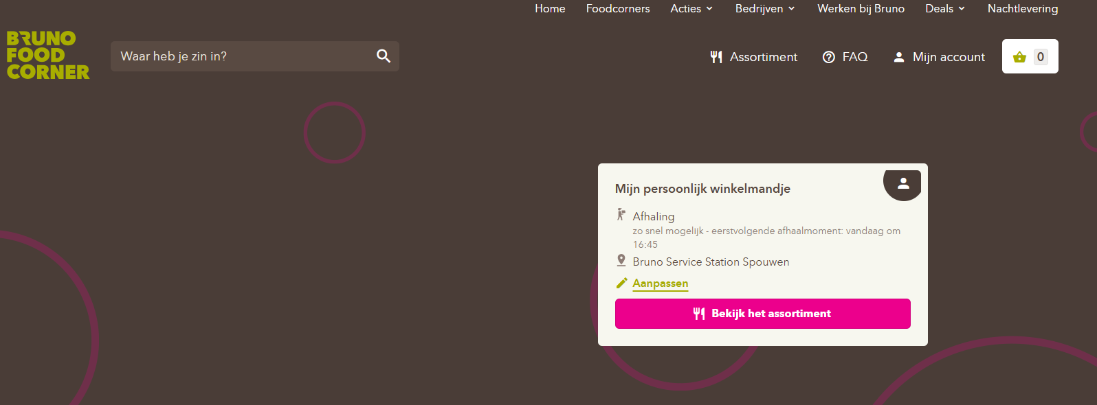
Step 2: Click on the pencil icon labeled (Aanpassen).

Slide 4
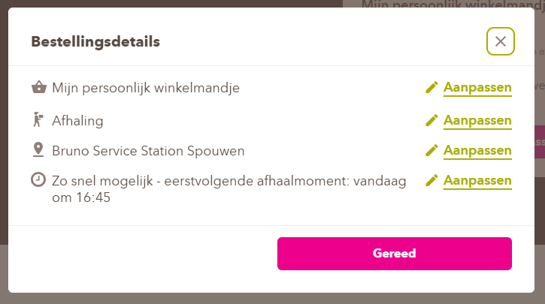
Step 3: Click again on the pencil icon (Aanpassen) next to ‘Mijn persoonlijk winkelmandje’ to edit it.
(Please note that if you want to place a personal order, you will need to adjust this setting.)

Slide 5
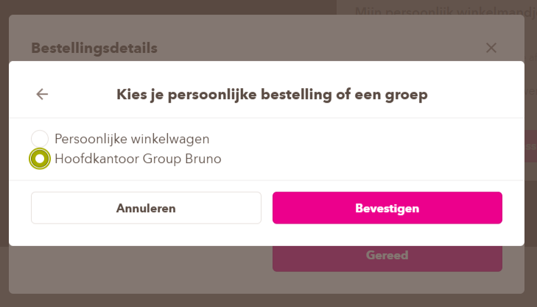
Step 4: Indicate on the basis of the (Dot) your group and then click on (Bevestigen).

Slide 6
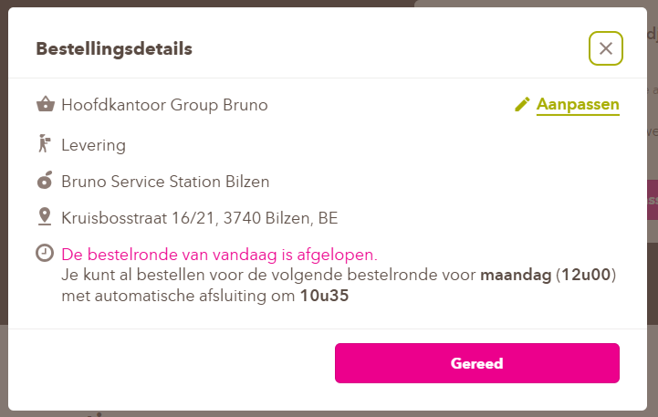
Your details have now been automatically adjusted to the group you have selected.
If your details are correct, click on (Gereed).

Slide 7
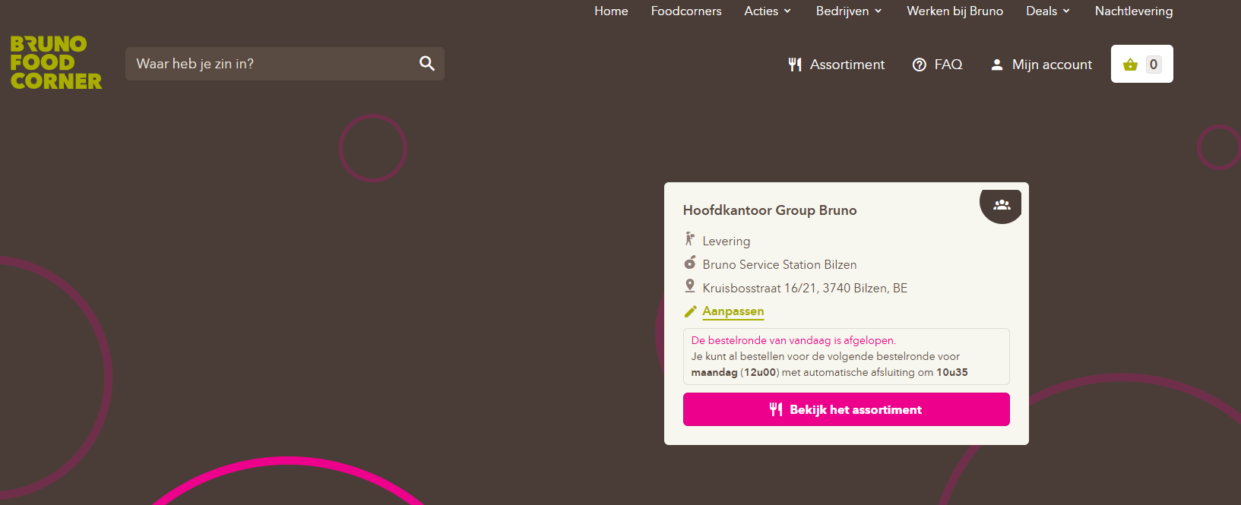
Step 5: Click on (Assortiment) and start choosing your delicious meal.

Slide 8
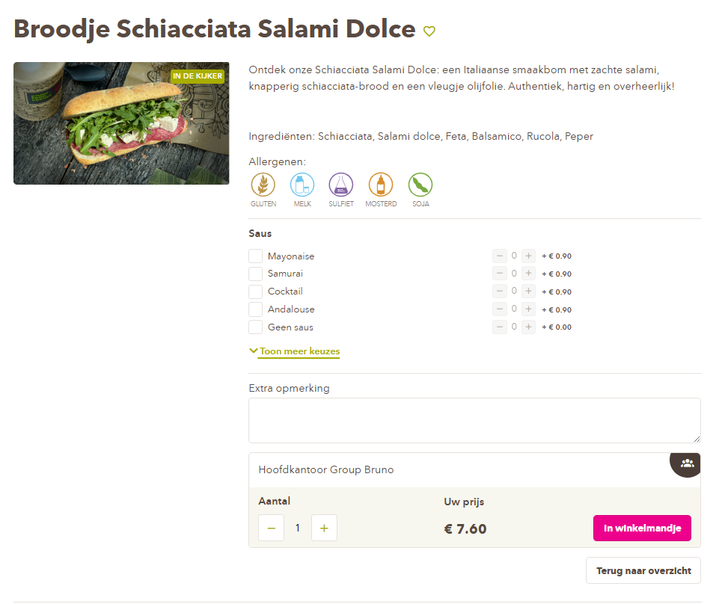
Step 6: Select your preferences and then add them to your shopping cart at the bottom of the page.
Double-check here to see if your group name is still listed.

Slide 9
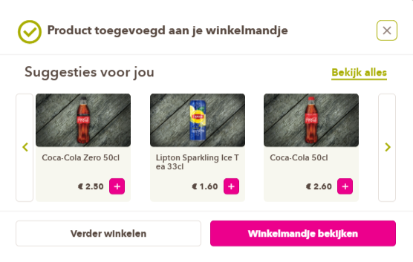
Step 7: Click on (Winkelmandje bekijken).
If you want to add additional products, click on (Verder winkelen) and repeat step 6.

Slide 10
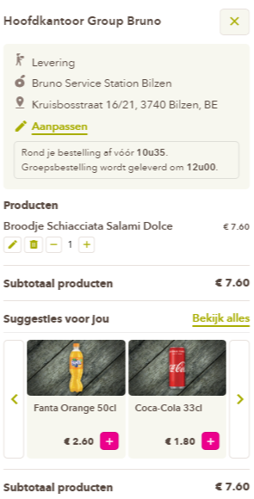
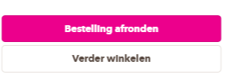
Step 8: Check your details and your order again and click on (Bestelling afronden).

Slide 11
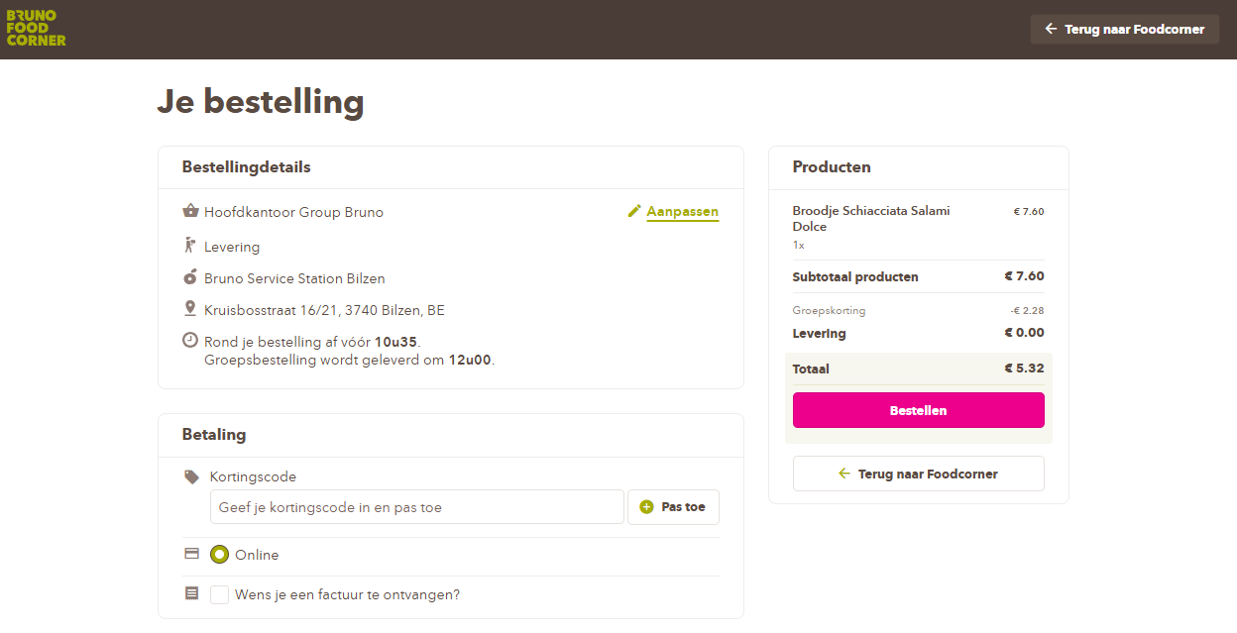
Step 9: A member of a group can only pay online.
Click on (Bestellen) right to complete the order.

Slide 12
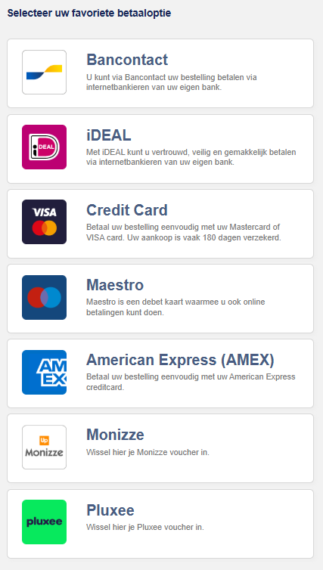
Step 10: Pay using your preferred payment method.

Slide 13
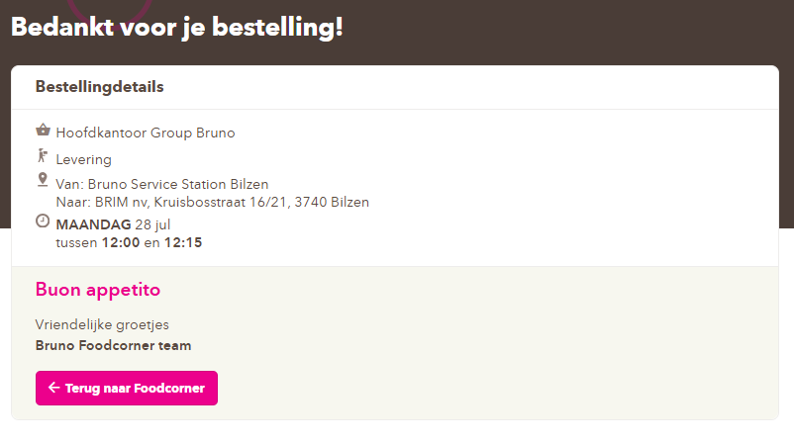
Once your payment has been successful, you will receive a confirmation on your screen and a confirmation email within a few minutes.

Slide 14
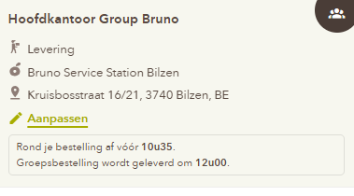
Important: You must place your order before a certain time to receive your products on the same day.
You can find this information when you edit your shopping cart.
Please note: If you order after that hour, your order will not be delivered until the next day.

