Slide 1

Manual for B2B group orders
Ordering on invoice

Slide 2
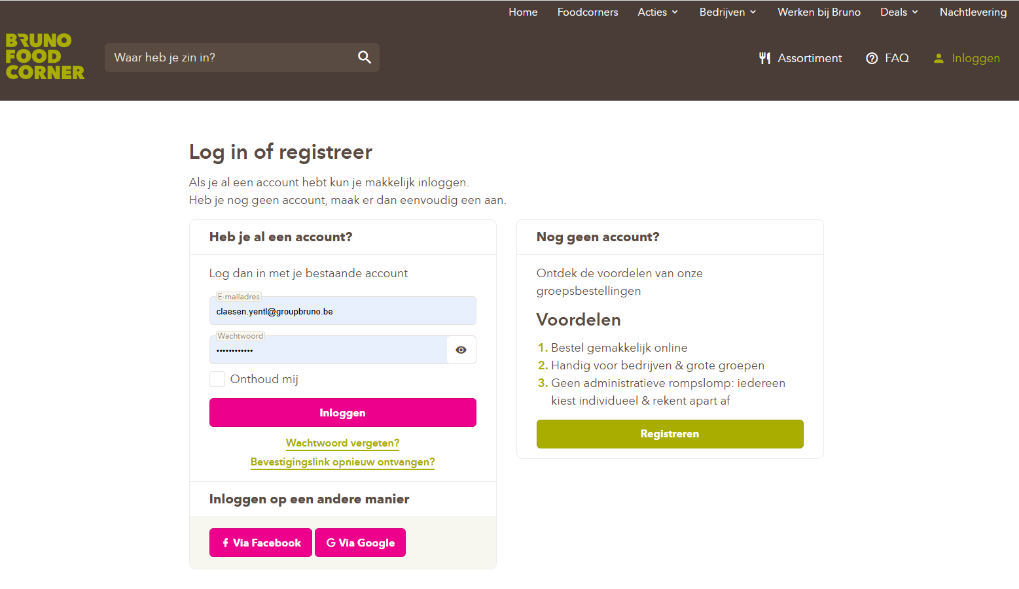

Step 1: Go to https://www.brunofoodcorner.be/nl and log in with your email address and password.

Slide 3
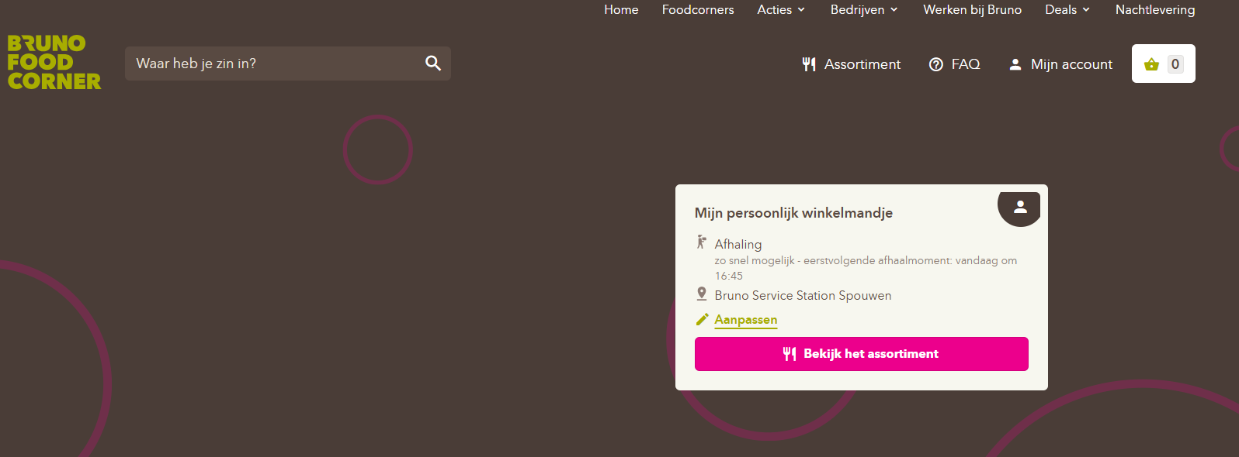
Step 2: Click on the pencil icon labeled (Aanpassen)

Slide 4
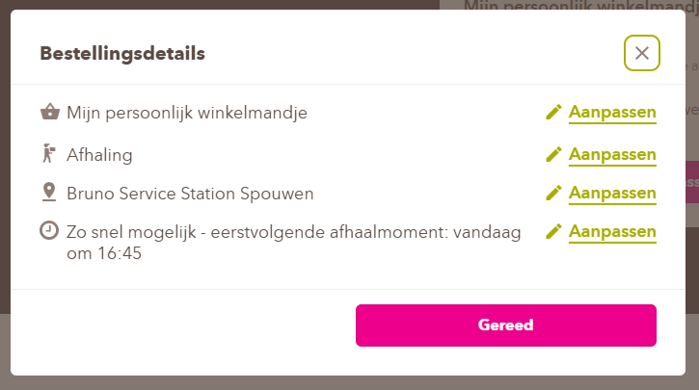
Step 3: Click again on the pencil icon (Aanpassen) next to ‘Mijn persoonlijk winkelmandje’ to edit it.
(Please note that if you want to place a personal order, you will need to adjust this setting.)

Slide 5
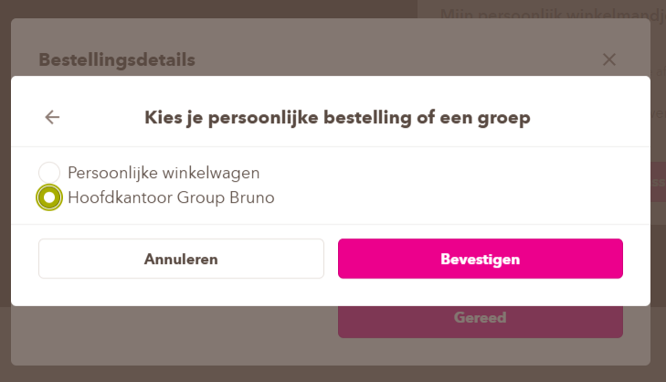
Step 4: Indicate on the basis of the (Dot) your group and then click on (Bevestigen)

Slide 6
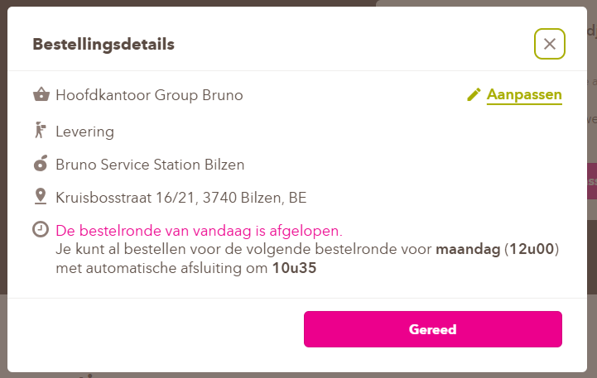
Your details have now been automatically adjusted to the group you have selected
If your details are correct, click on (Gereed)

Slide 7
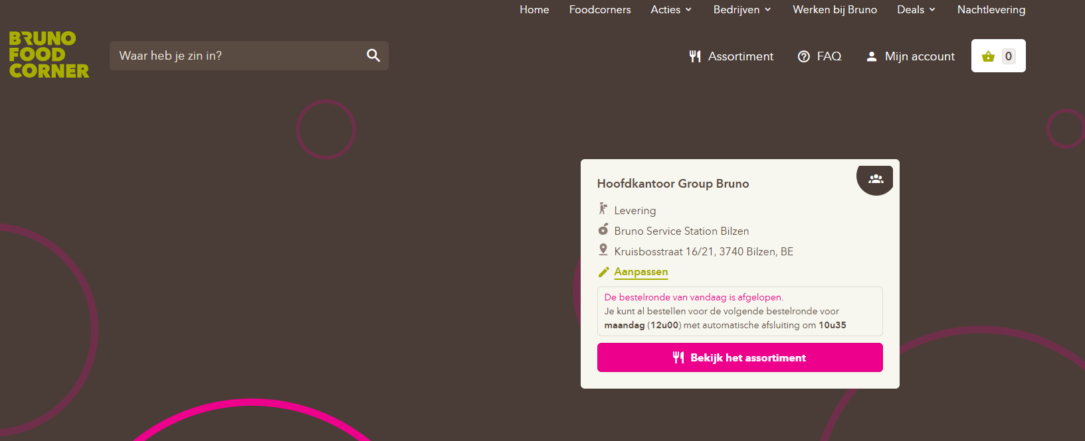
Step 5: Click on (Assortiment) and start choosing your delicious meal

Slide 8
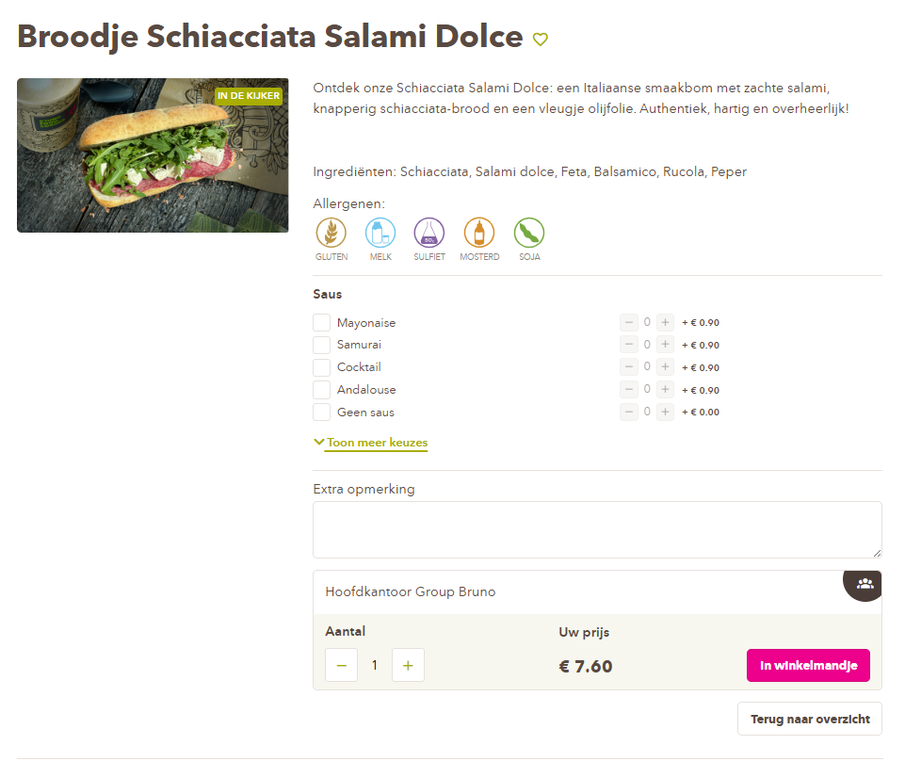
Stap 6: Select your preferences and then add to your shopping cart at the bottom of the page
Double-check here to see if your group name is still listed

Slide 9
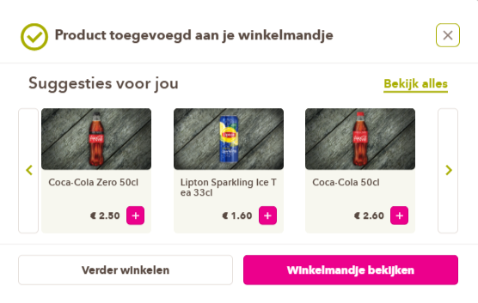
Step 7: Click on (Winkelmandje bekijken)
If you want to add additional products, click on (Verder winkelen) and repeat step 6

Slide 10
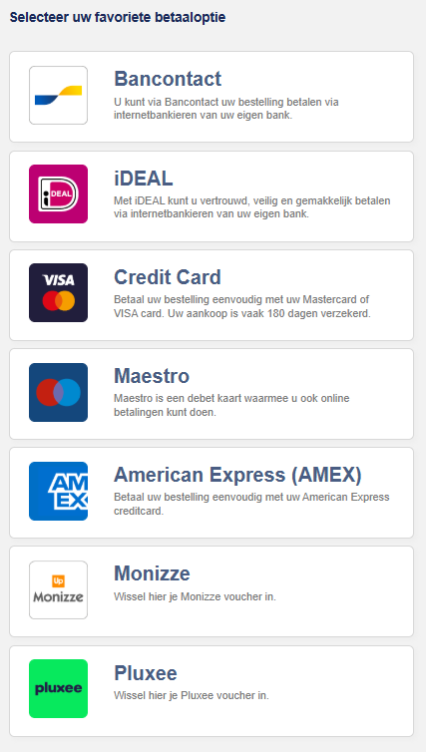
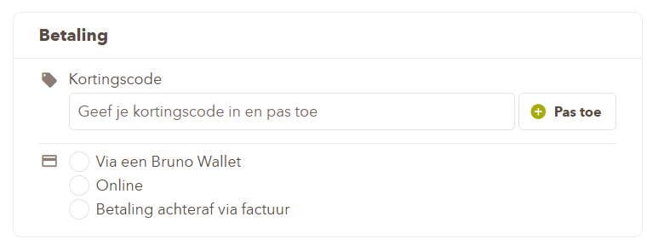
Or
Step 10: Pay using your preferred payment method

Slide 11
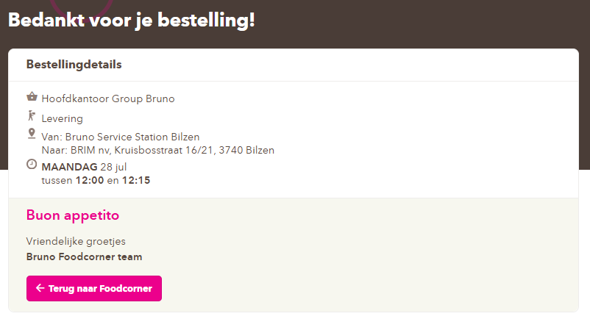
Once your payment has been successful, you will receive a confirmation and a confirmation email within a few minutes.

Slide 12
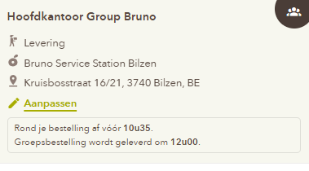
Extra info: You must place your order before a certain time to receive your products on the same day
You can find this information when you edit your shopping cart
Please note: If you order after this time, your order will not be delivered until the next day.

Slide 13
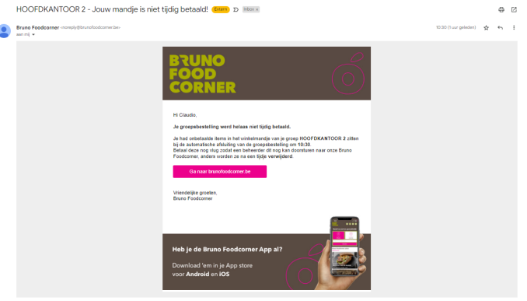
Extra info: If a member adds something to their shopping cart before the delivery time and after closing time
the administrator will receive a notification via email

